Slide 1
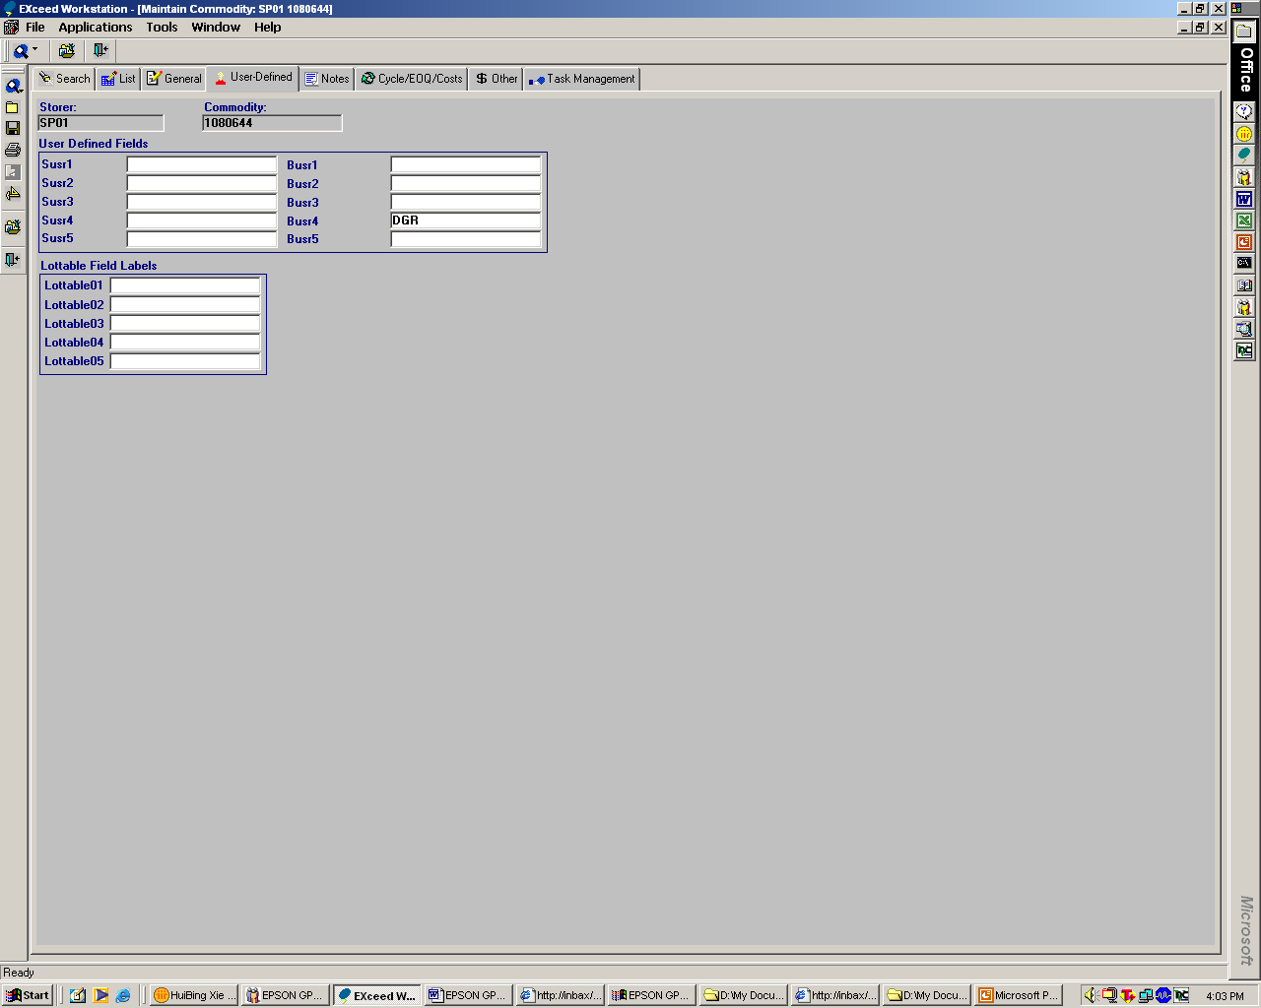
Flagging of DGR and Non-DGR parts
Logic to be build in
To input product category under ‘Busr4’ field
3 types of product category
a) Ink Cart
b) DGR (New requirement)
c) Non-DGR (New requirement)
d) Lithium Batt (New requirement)
Based on the product category under the ‘Busr4’ field, flag the respective remarks on the following documents
a) Packing List
-To flag 1) Ink Cart, 2) DGR, 3) Non-DGR and 4) Lithium Batt
b) Unallocated Shipment Order Summary
- To flag 1) DGR and 2) Lithium Batt
c) Inbound Tally Sheet (ITS)
- To flag 1) DGR
d) Wave Details
- To flag 1) Lithium Batt

Slide 2
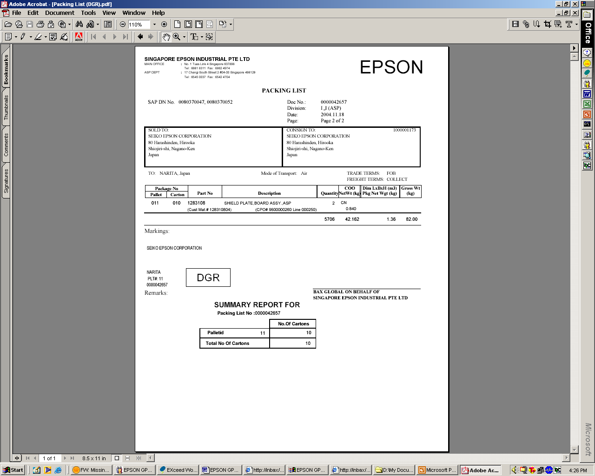
Packing List
To flag:
1) Ink Cart,
2) DGR
3) Non-DGR
4) Lithium Batt

Slide 3
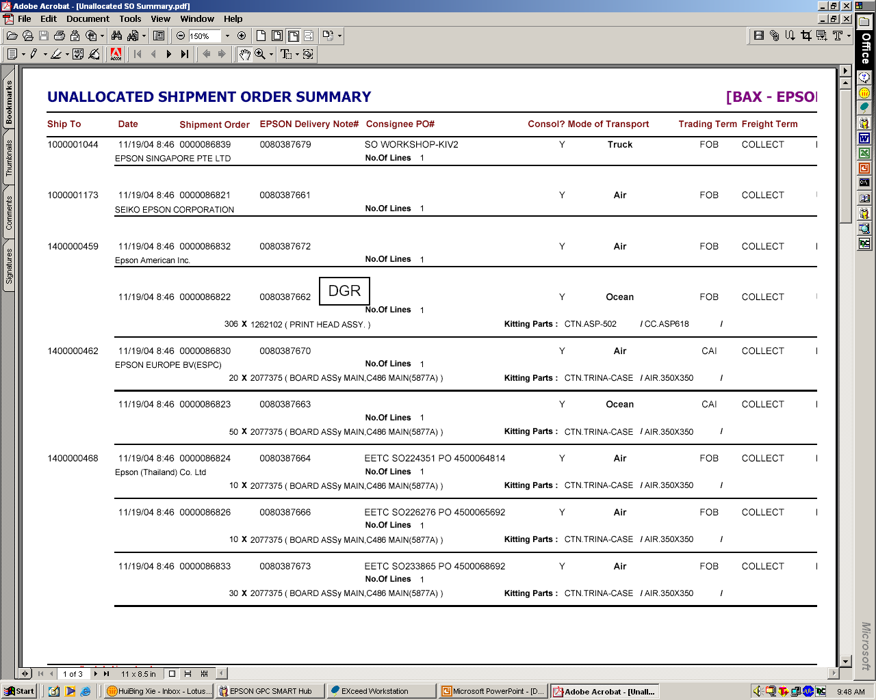
Unallocated Shipment Order Summary
To flag:
1) DGR and 2) Lithium Batt
To indicate Qty, P/N and Description

Slide 4
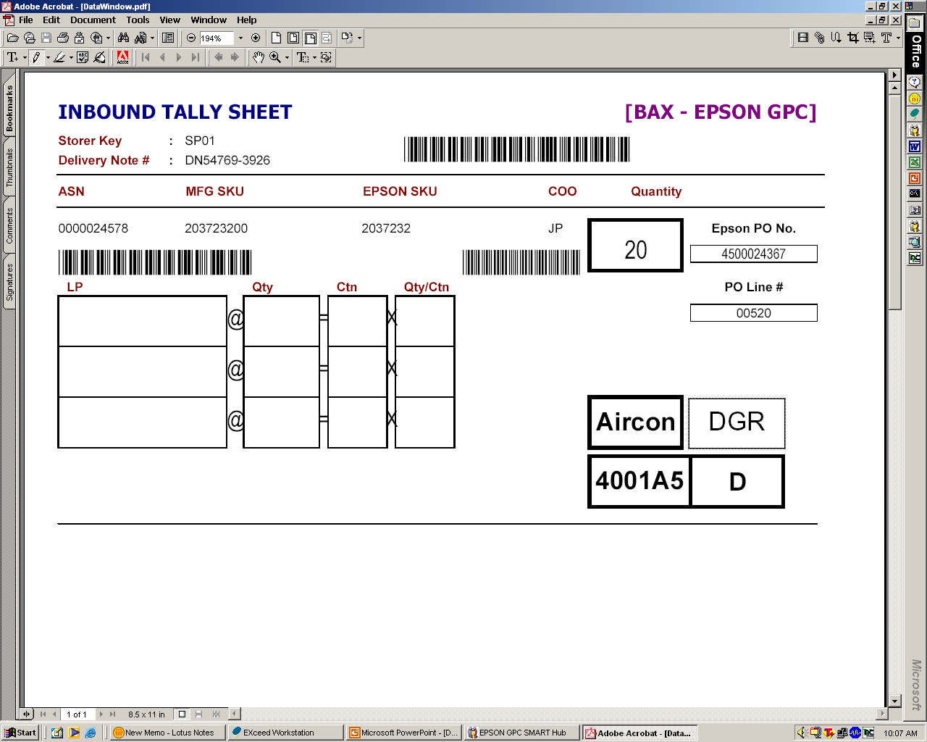
Inbound Tally Sheet (ITS)
To flag:
1) DGR

Slide 5
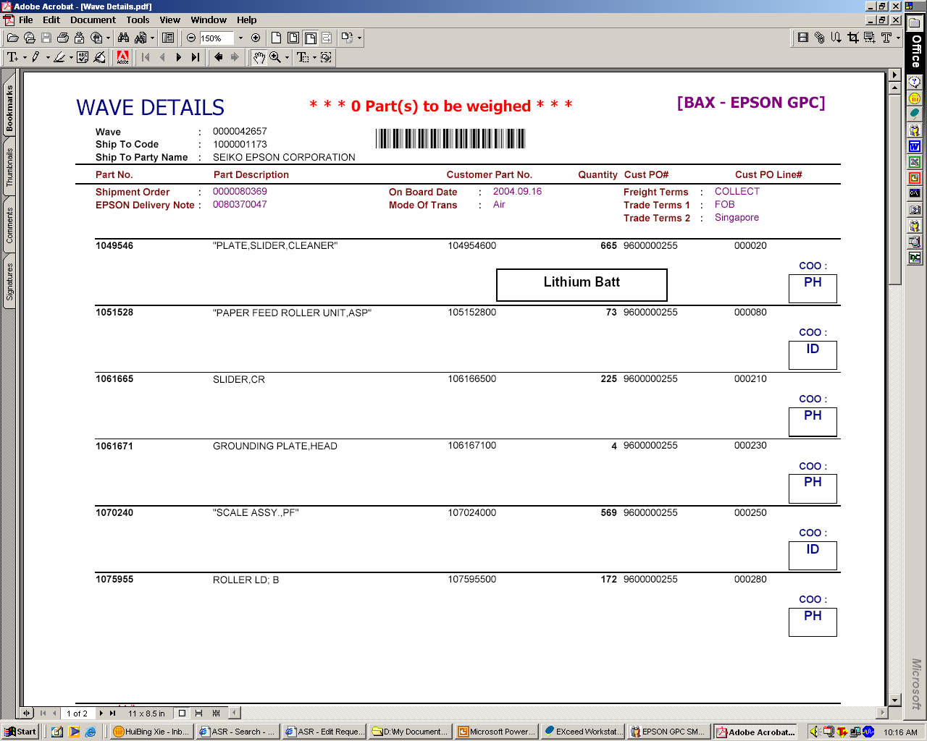
Wave Details
To flag:
1) Lithium Batt

